Slide 1
Challenge Fund for Youth Employment
Information Session on Call for Solutions | Kenya
September 30, 2022

Slide 2
Agenda
Introduction
The Fund explained
The Challenge in Kenya | County-based Development
Call for Solutions and Priorities of Selection
Portfolio Examples

Slide 3
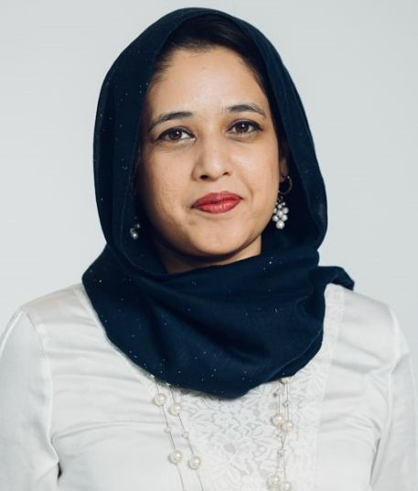
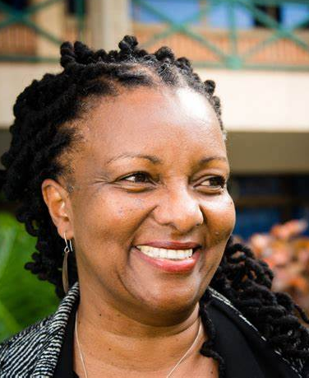
Kenya CFYE Team: Who’s Who?
Nimrah Karim
Scoping Lead, Call for Solutions
Wamuyu Mahinda
Pipeline Development Manager
Beatrice Gichohi
Country Lead, Kenya (Delivery)
Meriem Boukhari
Associate, CFYE Fund Management

Slide 4
The Challenge Fund for Youth Employment
1
About the Fund

Slide 5
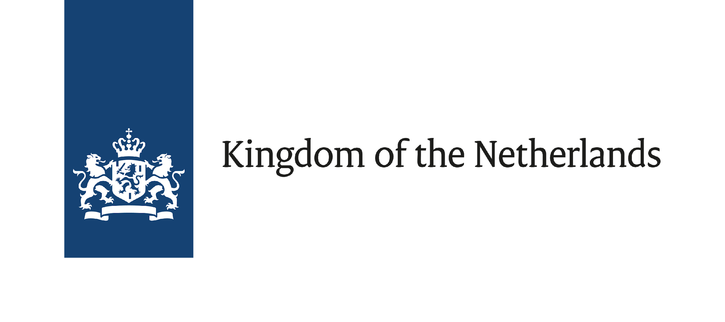
Partners
Notes:
The Challenge Fund for Youth Employment is funded by the Netherlands Ministry of Foreign Affairs and managed by Palladium, in partnership with VSO and Randstad.

Slide 6
The Challenge Fund Explained
Decent employment for 200,000 young people
By 2025, the fund aims to create decent employment for 200,000 young people including 100,000 women in the Middle East, North Africa, West Africa, and the Horn of Africa (including Kenya and Uganda).
Competitive challenges with focus on young women
We will run several competitive context-specific challenges per year to address supply, demand, or job-placement constraints to creating more jobs and/or improving the quality of work for people, especially women, aged 15-35 in the focus countries.
Goal
Approach

Slide 7
What the Fund offers
Co-investment
Technical Assistance
The Fund will co-invest a maximum of 50% of the total project budget.
In-kind technical support will be available throughout the selection process and during implementation to maximise delivery of results.
CFYE co-investment will have a minimum value of 200,000 Euros.
We will support approximately 5-10 projects in Kenya

Slide 8
Applicants will propose how they will...
Match
A young person is matched with, or finds a job that may or may not have existed prior to the CFYE co-funded intervention
Create
A young person takes up a job that has been newly created as a result of the CFYE co-funded intervention
Improve
A young person experiences improvements in working conditions within an existing job or business activity as a result of the CFYE co-funded intervention

Slide 9
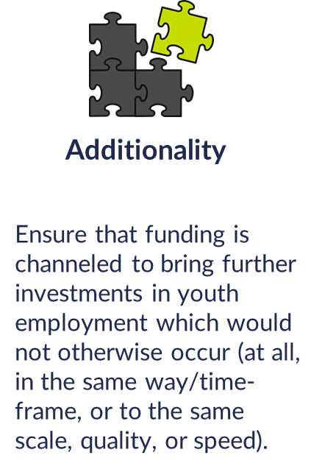
Selection Criteria
Private sector-driven
Engaging Youth
Including Women
Clear pathway to decent work
Involve a private sector partner and have a local presence
Young people should be directly involved in the design of the solution
Young women must be included and able to benefit, considering specific barriers women face
Demonstrate how project will result in at least 500 young people working in decent jobs or experiencing improved conditions

Slide 10
Where are we now?
Projects in implementation phase
Uganda, Egypt, Nigeria, Kenya, Jordan, Sudan
Projects in Inception Phase
Uganda (Round 2), Ethiopia, Morocco, Senegal, Tunisia, Burkina Faso
Upcoming Countries for Launch
Egypt, Nigeria, Kenya, Jordan (all are Round 2)

Slide 11
Challenges & Opportunities in Kenya Counties
2
Key findings from Scoping Research

Slide 12
Two Key Workstreams
In-country Research
Key Informant Interviews
Understand root causes of unemployment
Youth Sessions
Portfolio Development
Establish pipeline
Engage directly with prospects, analyze feasibility and fit
Publish call
A strategic call where CFYE can play an additional role in YE promotion
What are sustainable business opportunities that meet the objectives of CFYE?

Slide 13
Scoping Research
Scoping Report Annex
County Development
September 2022
Youth Aspiration Report
November 2020
Scoping Highlights Report
December 2020

Slide 14
Key Observations on Youth Employment in Kenya’s Counties
Key Challenges | Opportunities for CFYE support
Most entrepreneurs are necessity entrepreneurs & once they find work they are likely to close the business | Shift from low-productivity self employment to semi-formal employment Replicable and scalabe dependent self-employment using agency models Resilience support
Low skills of entrepreneurs – marketing, documentation, technical skills | Entrepreneurship development A2f, access to markets, access to technical skills
Low skills of employees | Upskilling programs + matching
Youth skills & aspirations = disconnected from realities of the labor market. Youth in rural areas are uninterested in traditional agriculture but prefer value addition | Activities in the agribusiness sector are labour-intensive and there is a long value chain.
Lack of access to land – youth are not actively involved in production of value chain products | Youth can be engaged in processing
Lack of coordination of ecosystem actors | Emphasis on partnership development/consortium building to fundamentally transform the youth employment ecosystem
Vulnerability of women is more pronounced – lower education, lower skilled, low mobility, low control of resources | Gender-transformative focus; based on unique norms in local environment Community engagement- involvement in design process Craft skills to utilize products along the value chain

Slide 15
Particular focus on:
Partnership/Consortium building between private sector employers and other actors, who will collaborate on solutions to impact youth employment
County-based approaches: Priority will be given to projects impacting jobs outside Nairobi County. Projects in Nairobi are also eligible to apply.
Systemic solutions: Priority will be given to innovative models that aim to address systemic bottlenecks, positively impacting the ecosystem as a whole.
Round 2 will build on the priority sectors identified in the previous round, and add the growing Creative sector.

Slide 16
Call for Solutions
3
& Eligibility Criteria

Slide 17
Call for Solutions: Priority Windows
The project must meet the minimum eligibility criteria for job targets (at least 500 jobs) through a combination of CFYE categories: create, match or improve.
Window: Description
Digital Business Dev’t Services | Digital business development services using technology to create new value in business models, customer experiences, and the internal capabilities that support its core operations, has high potential to impact jobs at scale. This window covers e-commerce as well as traditional brick-and-mortar players that are transforming their businesses with digital technologies. There is also potential for providing opportunities for women, as the work often enables remote work and flexibility in timings. Moreover, digitally-enabled jobs align strongly with youth aspirations.
Scaling up Green Jobs | Green jobs refer to employment opportunities in businesses that have a direct, positive impact on the environment, such as those involving renewable energy, energy efficiency or nature conservation. Projects in this window would impact jobs in environmentally & socially sustainable activities in agriculture, agribusiness, waste management & recycling industries. Additionally, we are interested in supporting manufacturing companies transitioning to low-carbon models such as in the construction and transport sectors.
The Creative Sector | Kenya’s vibrant creative sector shows tremendous potential for providing income generation opportunities for youth. Sub-sectors such as crafts, fashion design, film, music, writing, visual art are examples of the vibrant talent brimming in Kenya, yet not seriously pursued as a career path by youth. Entrepreneurs within the creative sector are primarily informal. They typically lack business skills, and have little incentive or know-how to formalize their operations. CFYE is looking for innovative solutions to support entrepreneurship development, improve existing jobs, and create or match employment opportunities at scale in this sector.
Please note: While priority will be given to these windows, applications that fall outside these windows will also be accepted.

Slide 18
Examples of Potential Projects
Create: Jobs can be created where SMEs become appointed retailers or agents for manufacturing organizations. This has created job opportunities for youth and women, especially where training on the job is included to ensure business success.
Improve: Many young people have gone through technical institutions and gained skills in carpentry, masonry, and dressmaking to mention some. They may have jobs but do not earn enough. CFYE is supporting organizations that are Upskilling the youth to meet the market needs thus improving their jobs
Match: Consortium of E learning/training platforms and private sector companies in the ICT sector can provide demand-driven digital training, and can match youth with available openings in these companies.
Match: Company looking to expand operations by investing in skills development of young women in a remote area, followed by hiring of trained youth.

Slide 19
Applicant Profile
We strongly invite applications from private sector companies, as we believe that private sector involvement is the most effective way to test market-based solutions that respond to the challenge of youth employment.
Non-profit entities may apply, but if they are the lead applicant, they must apply in consortium with a private-sector employer with ability to impact jobs through create, match, improve
We particularly welcome partnerships or consortium responses to this challenge
Priority will be given to projects impacting jobs outside Nairobi county. Projects in Nairobi are also eligible
The applicant must be able to begin operations no later than March 2023..

Slide 20
Budget Guidelines
CFYE co-investment must be minimum €200,000.
The range for CFYE co-investment is 20-50% of the total project budget.
The CFYE co-investment requested cannot exceed the total turnover of the Lead Applicant in the previous year (if the applicant has been operational for more than 1 year)..
There is no maximum CFYE co-investment stipulated, but we will consider whether the budget is realistic and whether the applicant can raise the required co-funding. We will also assess if the CFYE cost per job is competitive.
The company’s in-kind contributions must not exceed 30% of its total co-investment.
Capital investment (CapEx) requests from CFYE must not exceed 33% of the total investment.

Slide 21
Portfolio Examples
3
Selected IPs from Kenya Round 1 Call for Solutions

Slide 22
CFYE Kenya Portfolio Example: Meru Greens
An example of a partnership in agribusiness are our implementation partners Meru Greens (MG) and Edukans.
MG will:
decentralize the pre-processing from the urban (Nairobi) area to three rural locations and equip the new facilities and staff with the appropriate resources and knowledge.
create at least 500 decent jobs for youth, especially young women, and improve 200 already existing jobs.
engage in the following activities: setting up pre-processing locations, recruiting and training human resources, improving decent work conditions, greening the green beans value chain, reducing post-harvest losses, limiting transportation, providing training to increase inclusion and participation of women and youth, monitoring the implementation of improved decent work policies, and ensuring the sustainability of activities after the project end.
Edukans, with their cost-effective quality skills training methodologies, will:
support Meru Greens to close the gap between the youths’ and the market-required skills.
focus on involving diverse and vulnerable youth and empowering them with the required technical and life skills.

Slide 23
CFYE Portfolio Example: Shujaaz
Shujaaz Inc and Unilever Kenya have collaborated to develop an agency model.
The project seeks to create decent work for at least 10,000 young Kenyans (of which 6000 are women) through a unique collaboration between Unilever Kenya and Shujaaz Inc’s network of ventures. The programme aims to identify, recruit, and train young, aspiring retailers among Shujaaz Inc’s network to become official Unilever retailers, focusing on young women.
In Phase 1, Shujaaz Inc will launch a campaign across its national multimedia platform, ‘Shujaaz’. The campaign will be designed to recruit thousands of high-potential young entrepreneurs from its 7.7m audience of young Kenyans.
In Phase 2, recruitees will be invited to sign-up for ‘MESH’ – where retailers will have access to online training materials developed alongside Unilever Kenya to equip them with the skillsets they need to succeed as Unilever retailers.
As part of MESH, retailers will be able to build their professional networks and access peer mentorship opportunities. MESH will connect 10,000 qualified young retailers with Unilever’s digital distribution and sales operations.
These newly-trained and networked Unilever vendors will be set up with decent and reliable work as part of the Unilever network.
In the future, MESH members will have access to credit and financial services to continue their growth in retail with Unilever Kenya and other partners.

Slide 24
How to Apply?
For instructions on how to apply, please view the recording on
“How does the Call Application and Selection Process Work?”
uploaded on our Kenya page.

